Slide 1

DEPARTMENT OF COMPUTER ENGINEERING
Radiant Games - Online Games Store (SE-A-17)
Students name:
Pranil Belge(11)
Aaryan Chothani(20)
Dipesh Jaiswar(54)
Suyash Kannaujiya(59)
Under the Guidance of: Prof. Vandana Virbhadre

Slide 2
Problem statement
It is not very efficient to buy physical copies of video games as they are not always available and therefore hard to find. There is also a risk of these copies being damaged and thus being useless.
Objectives
To solve the problem of searching for physical copies of video games and making majority of the most popular video games available online at one location.
Radiant Games - Online Games Store

Slide 3
Work Completed
Main/Front Page – with login/signup sections
Browse Page
Cart
Wishlist
Library
Checkout
Receipt System
Detailed Pages for Games
Radiant Games - Online Games Store

Slide 4
Work Pending
Minor styling changes
Radiant Games - Online Games Store

Slide 5
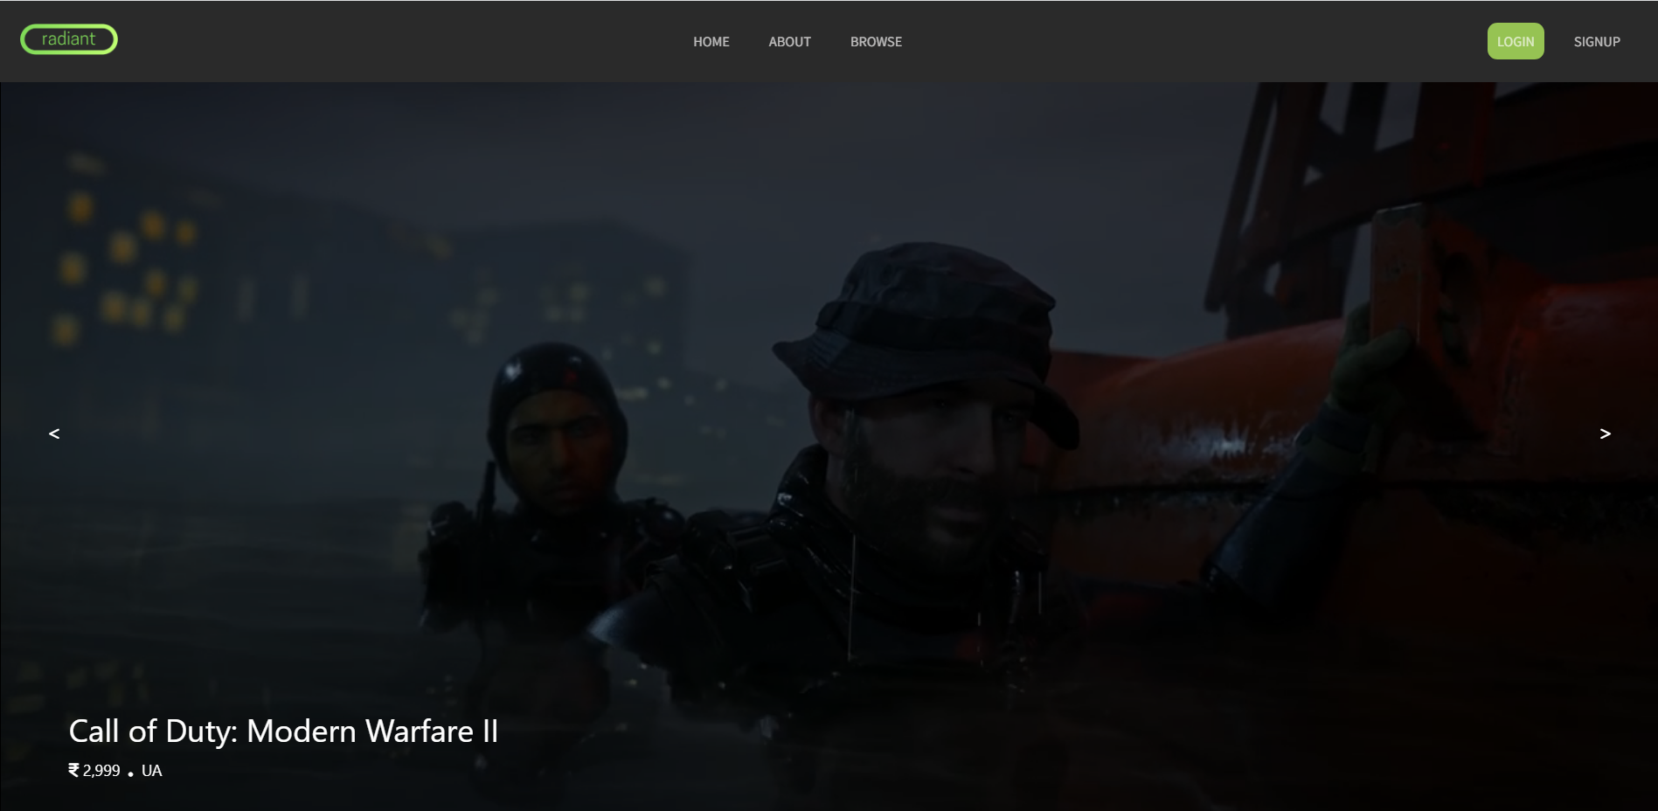
Main page illustration

Slide 6
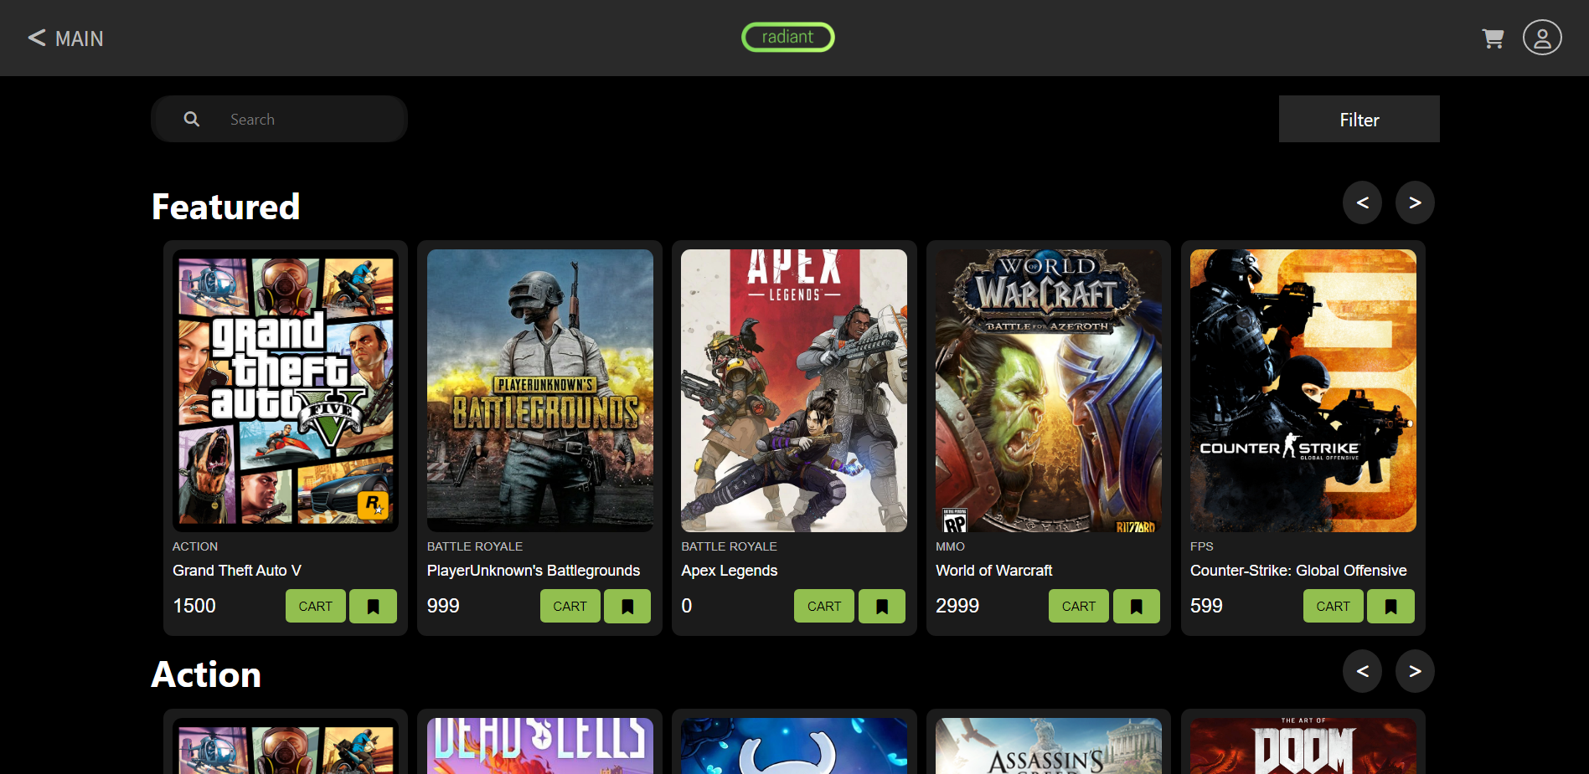
Browse Page

Slide 7
Technology Stack
HTML & CSS
JavaScript
PHP
MySQL
Radiant Games - Online Games Store

Slide 8
References
https://store.epicgames.com/en-US/
https://www.gamestheshop.com/
https://www.w3schools.com/
https://www.geeksforgeeks.org/html/
https://www.javatpoint.com/html-tutorial
Radiant Games - Online Games Store

Slide 9
Thank You

